Slide 1
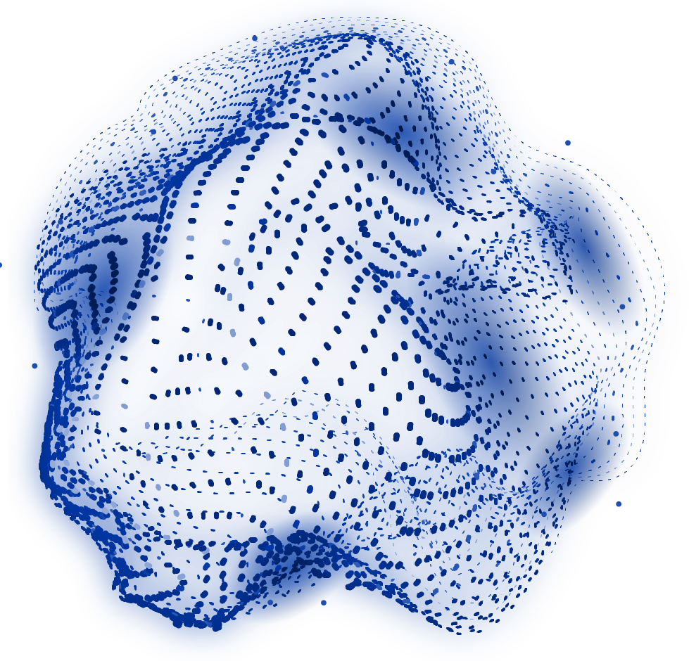


MedAssist AI
MILESTONE 2 (Disease Prediction & Risk Assessment)
Dharani K

Slide 2
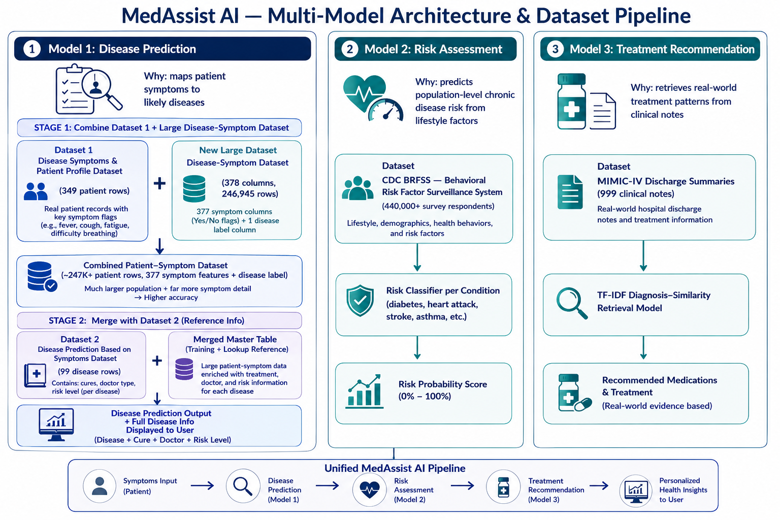
Train disease prediction models

Slide 3
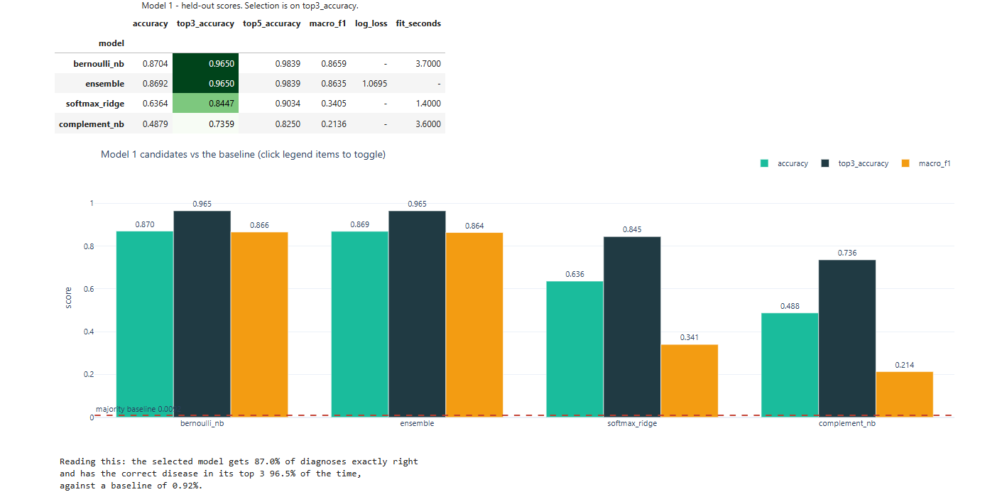
Model performance and accuracy

Slide 4
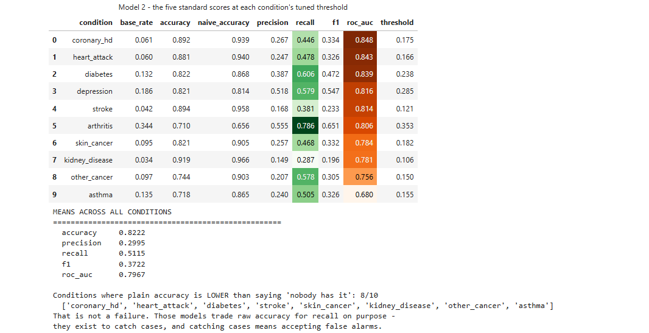
Model performance and accuracy

Slide 5
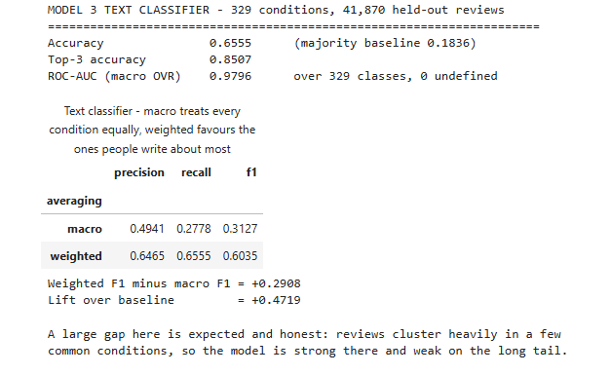
Model performance and accuracy

Slide 6
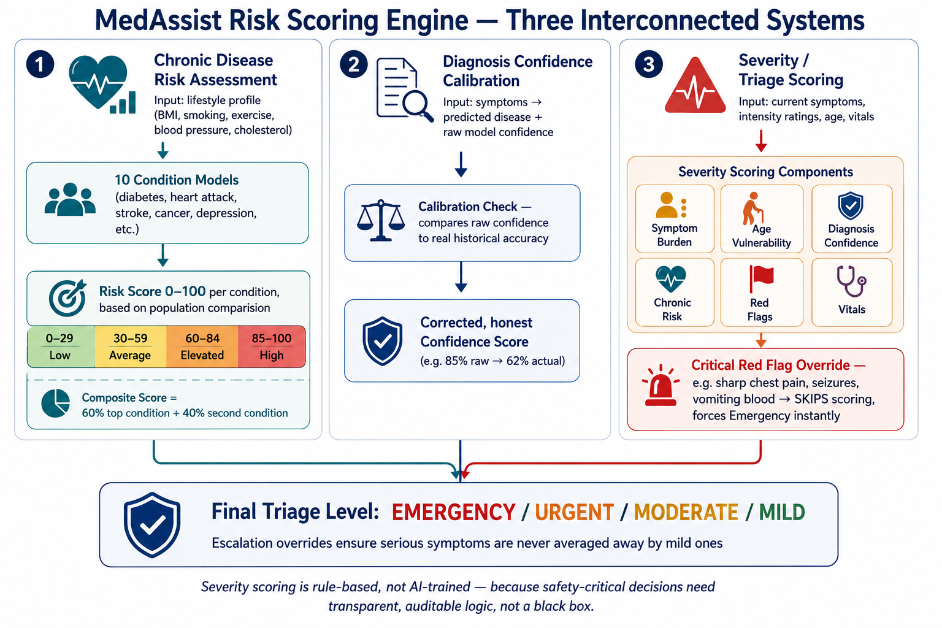
Risk scoring engine

Slide 7
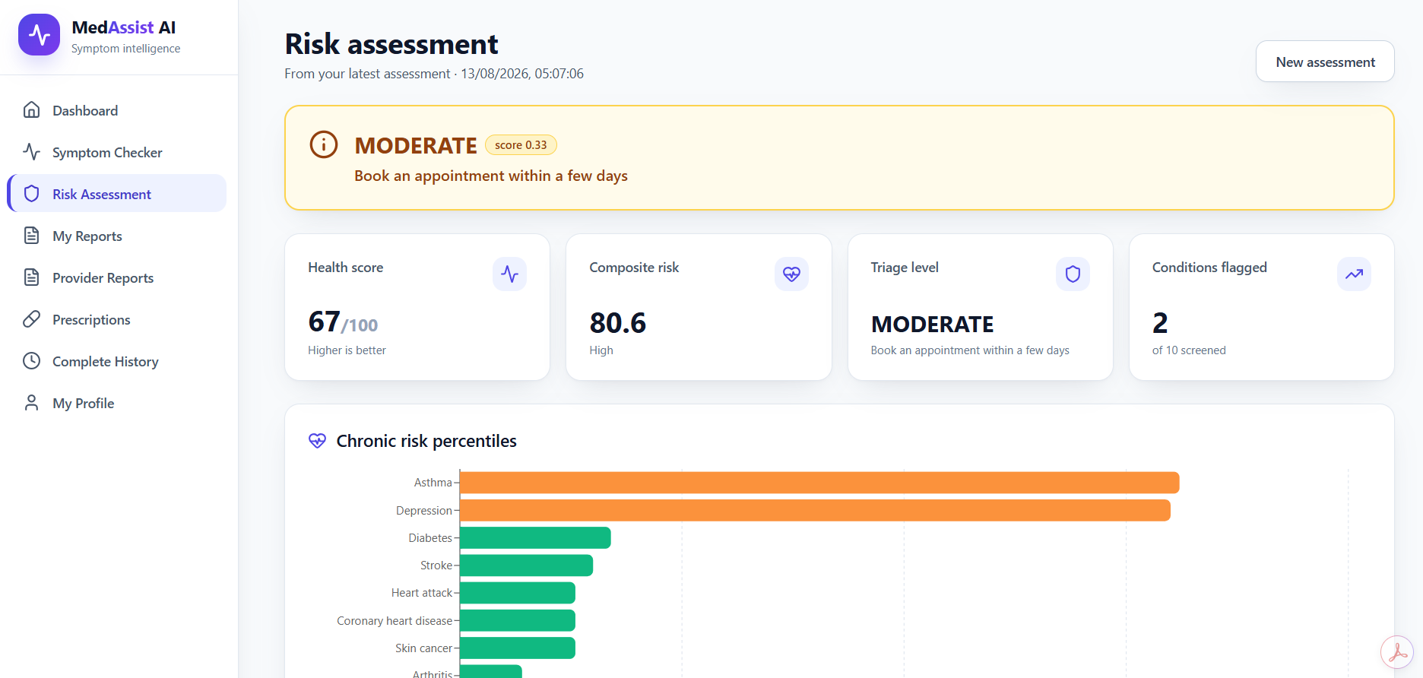
Risk scoring engine

Slide 8
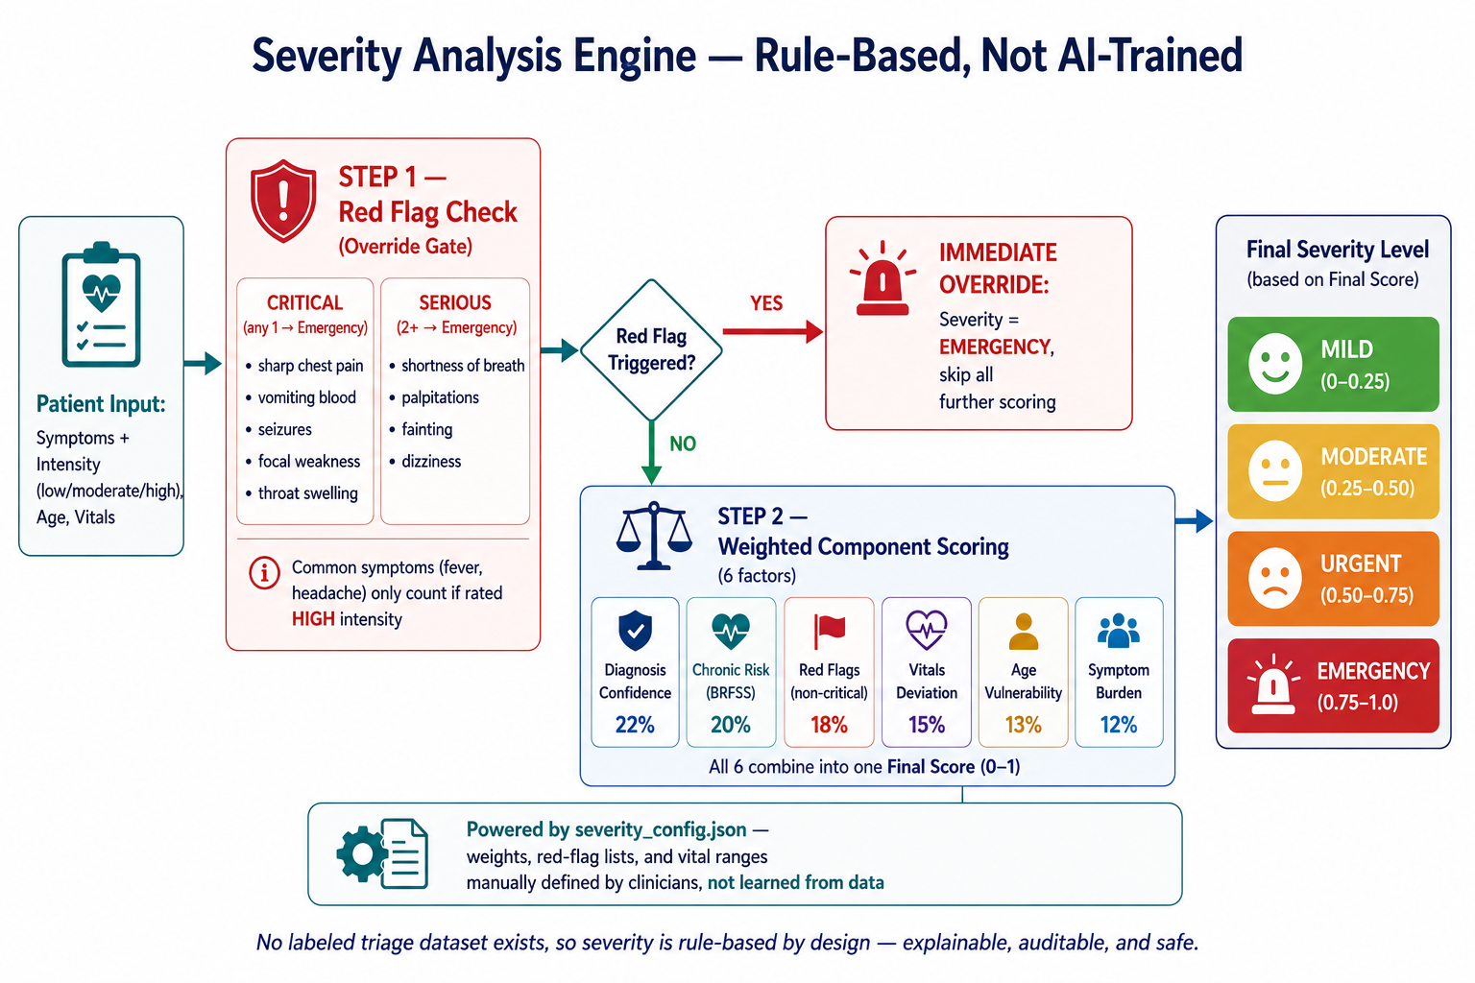
Severity analysis workflows

Slide 9
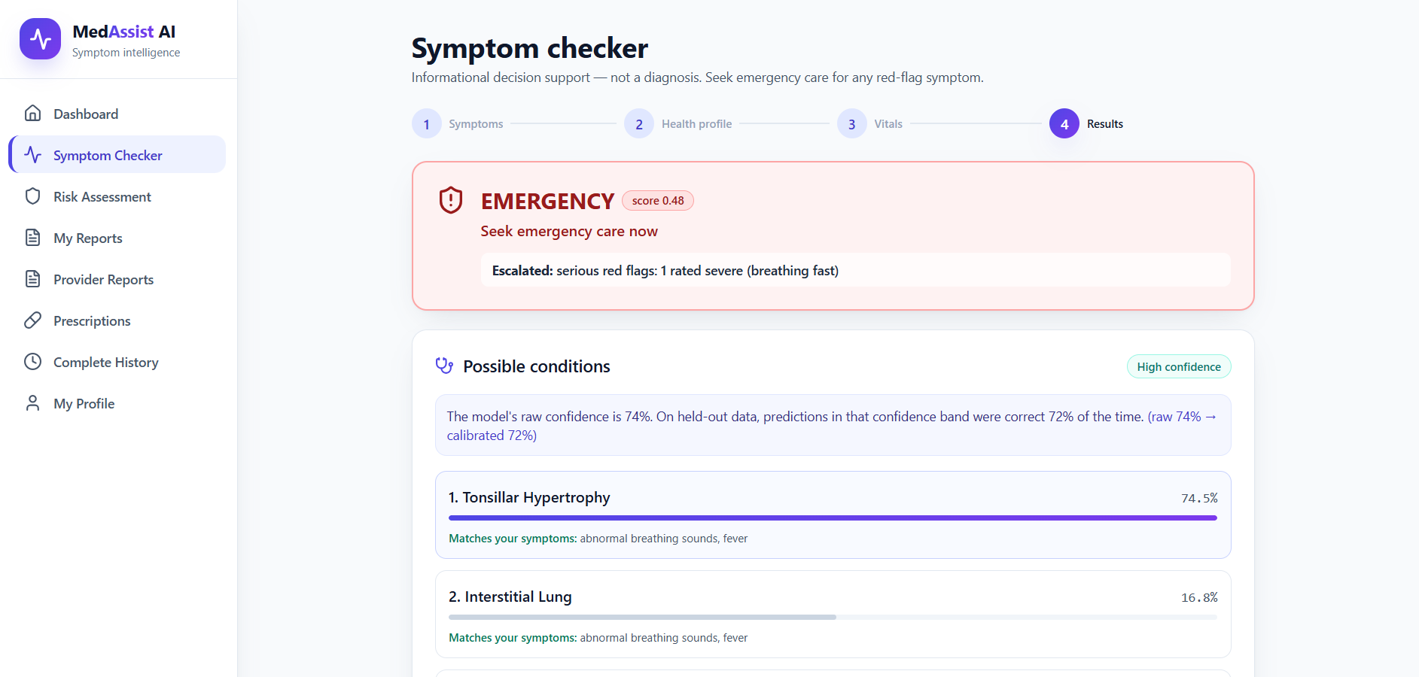
Severity analysis workflows

Slide 10
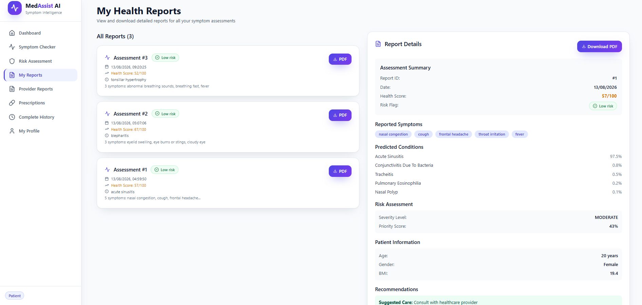
Disease Probability Report and health risk report

Slide 11
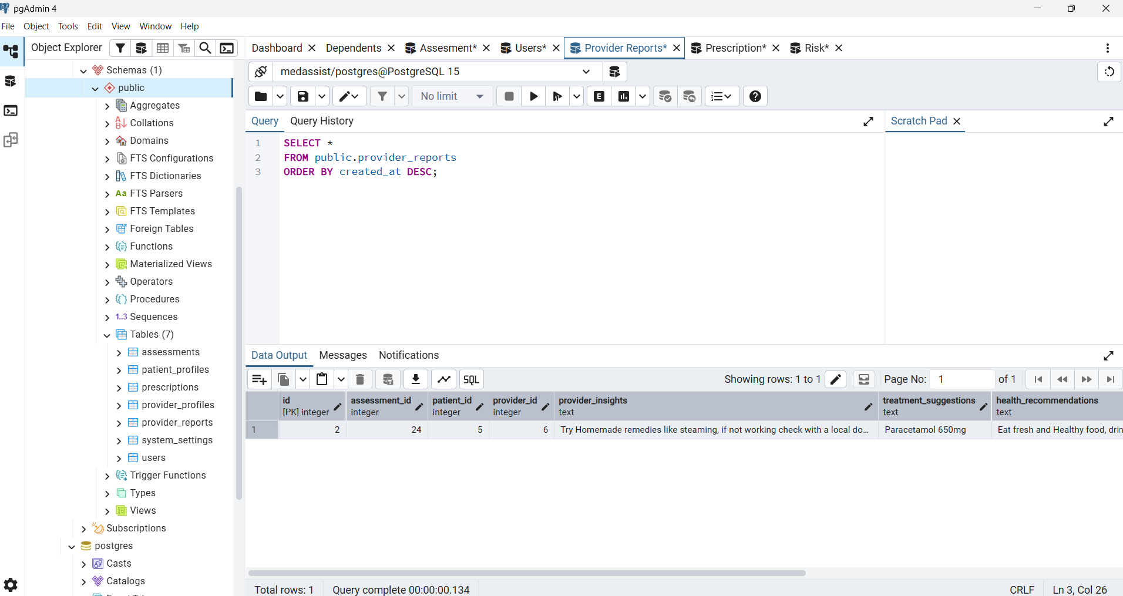
Database - PostgreSQL

Slide 12

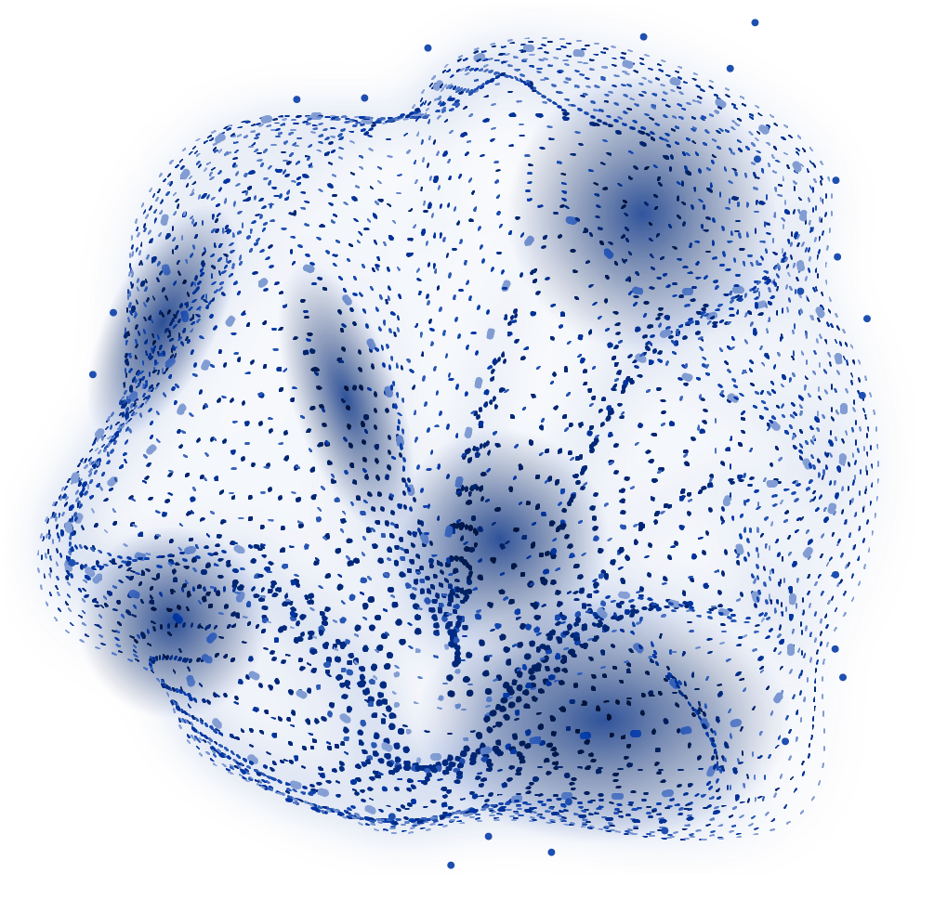
THANK
YOU!

